Slide 1



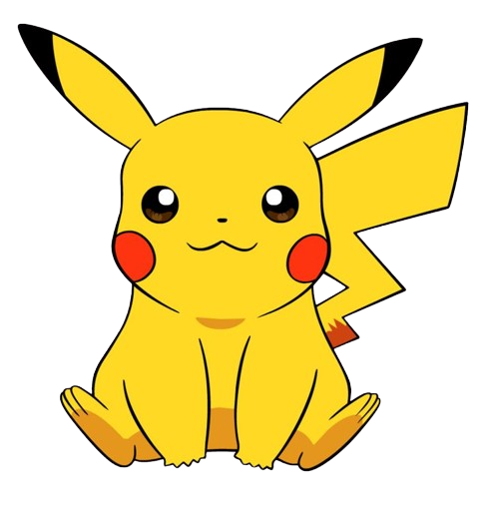

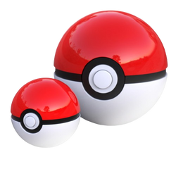

ENDAH RAKHMAWATI
EXPLORATORY DATA ANALYSIS
Digital Skill Fair 29 - Data Science

Slide 2
DATASET
BIT.LY/DATA-POKEMON-DSF

Slide 3

# : DISTINCT NUMBER OF POKEMON SIMILAR NAME
NAME : THE ENGLISH NAME OF THE POKEMON
TYPE 1 : THE PRIMARY TYPE OF THE POKEMON
TYPE 2 : THE SECONDARY TYPE OF THE POKEMON
TOTAL : AGGREGATION OF POKEMON STATS
HP : THE BASE HP OF THE POKEMON
ATTACK : THE BASE ATTACK OF THE POKEMON
DEFENSE : THE BASE DEFENSE OF THE POKEMON
SP. ATK : THE BASE SPECIAL ATTACK OF THE POKEMON
SP. DEF : THE BASE SPECIAL DEFENSE OF THE POKEMON
SPEED : THE BASE SPEED OF THE POKEMON
GENERATION : THE NUMBERED GENERATION WHICH THE POKEMON WAS FIRST INTRODUCED
LEGENDARY : DENOTES IF THE POKEMON IS LEGENDARY.
COLUMNS DICT

Slide 4

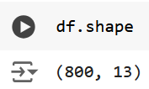
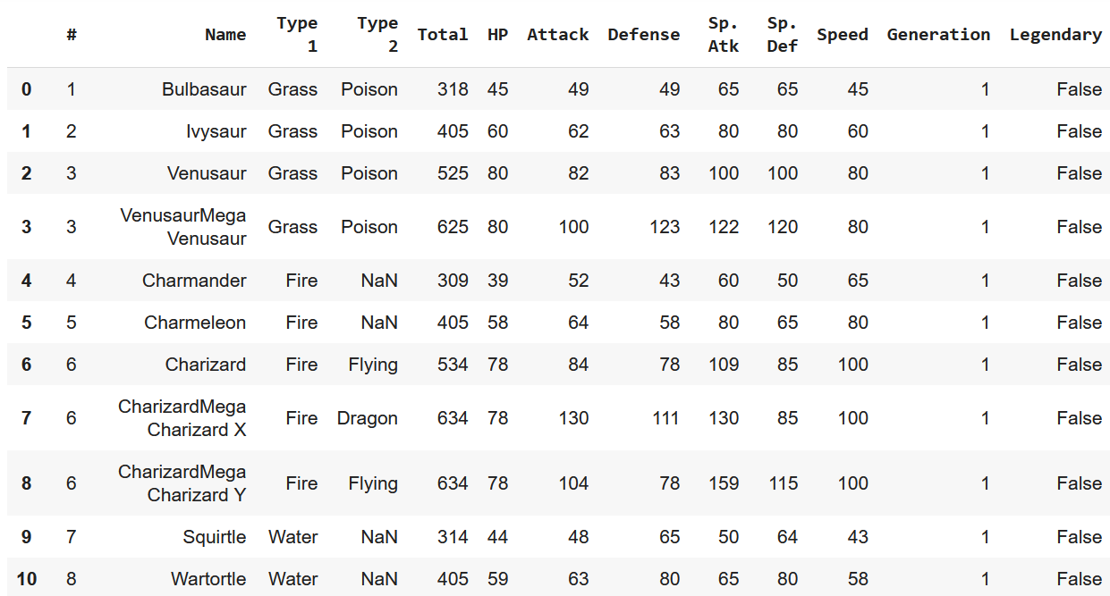
DATA FRAME

Slide 5
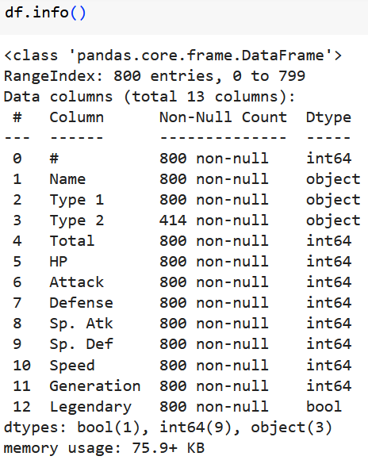
There are 3 categorical variables, 1 boolean and 8 numerical variables.
DATA CLEANING
From inspection of the data above, it can be seen that column Type 2 has null value.

Slide 6
LET'S EXPLORE THE DATASET

Slide 7

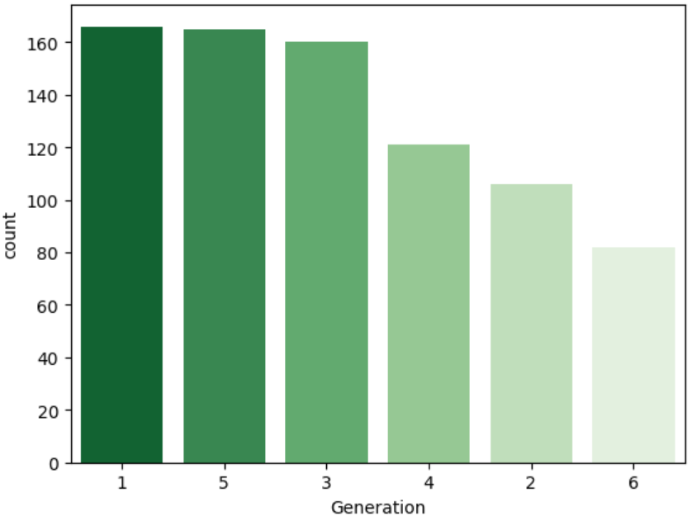

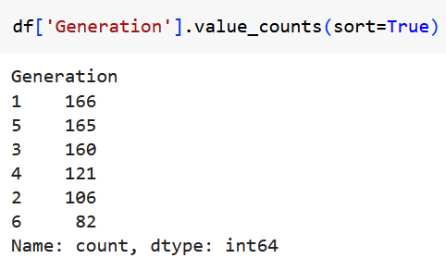
How many pokemons are there per Generation?
The generation with the most is the 1st generation with 166 Pokemons.
The generation with the fewest is the 6th generation with 82 Pokemons.

Slide 8
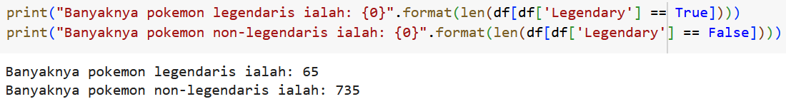
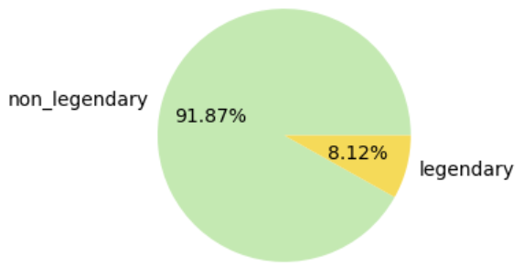
How is the pokemon percentage by Legendary label?

Slide 9
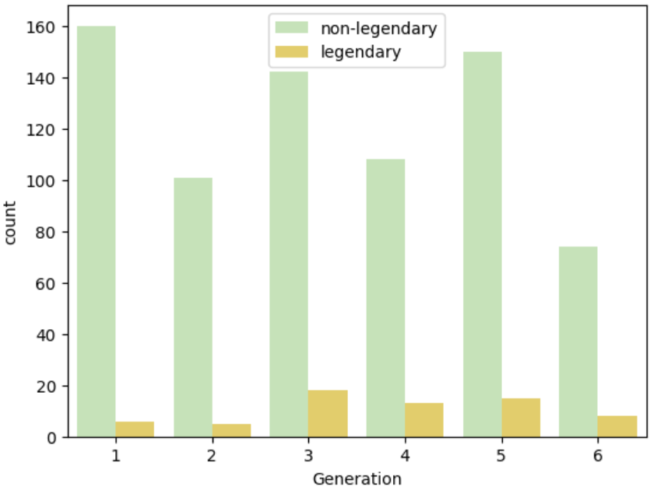
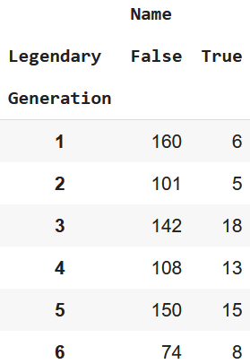
The distribution of total pokemons by Legendary
The highest total number of Legend Pokemon is 3rd generation, 18 pokemons.
The highest total number of non-Legend Pokemon is 1st generation, 160 pokemons.

Slide 10
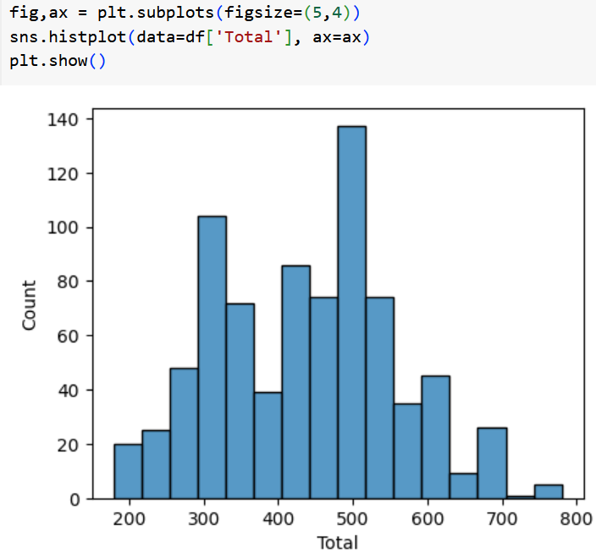
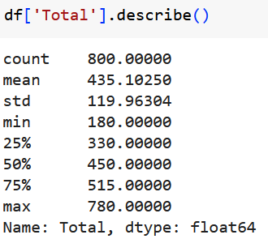
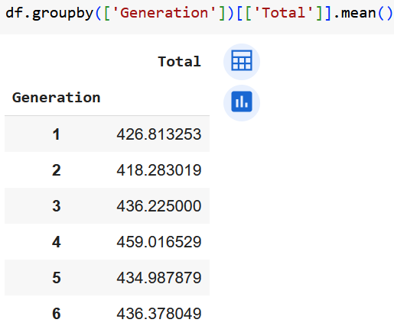
The distribution of total base statistics can be seen in the output below.
Most of pokemons
have the total stats around 500. It's above the total average 435.
The total average per Generation is over 400. Gen 4th has the highest average, over 450.

Slide 11
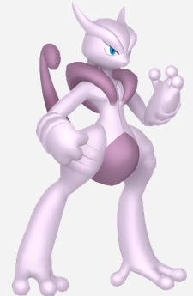
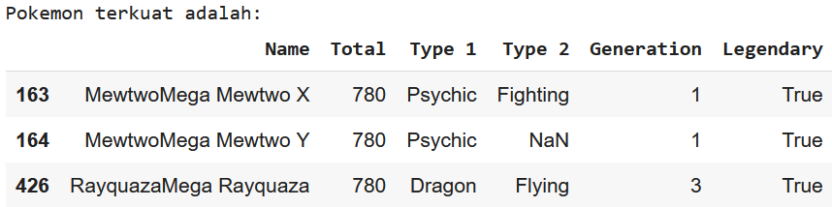

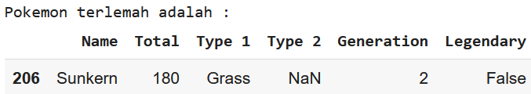
Which pokemons are the strongest and the weakest of all?
3 of them are the legend pokemons, which have the highest total stats of all, 780
Sunkern, the non-legend pokemon has the weakest total stats of all, which is 180

Slide 12

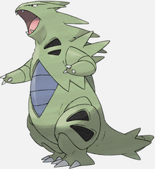
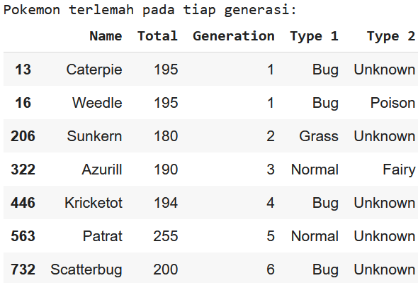
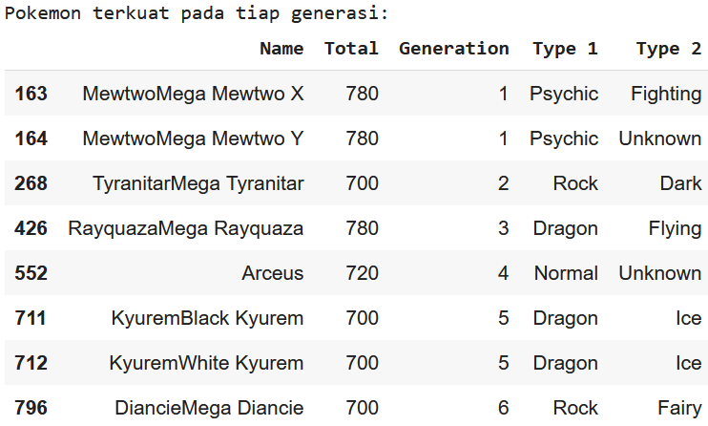
What is the strongest and the weakest pokemon for each generation?
The highest total stats for each generation is in the range 700 to 780
The lowest total stats for each generation is in the range 180 to 255

Slide 13
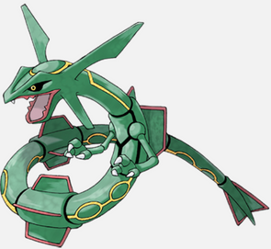

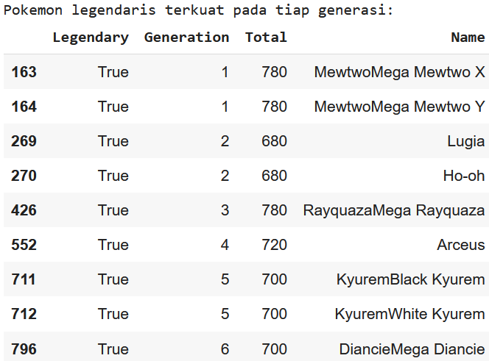
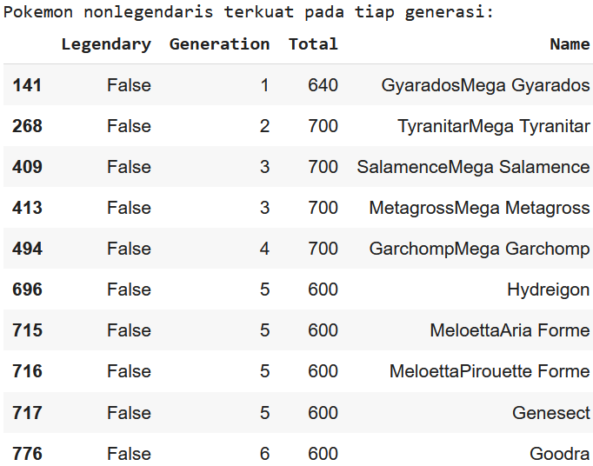
What are the strongest legendary and non-legendary Pokemon of each generation?
The highest total stats of legendary cluster is in the range 680 to 780
The highest total stats of non-legendary cluster is in the range 600 to 700

Slide 14
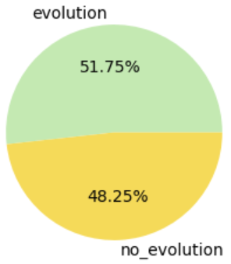
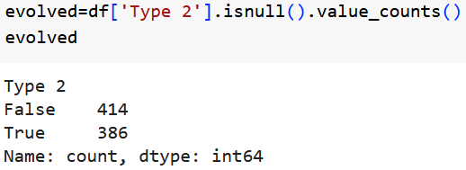
What is the percentage of the evolved pokemon?
If the secondary type is empty then it means the pokemon has not evolved.
There are 414 pokemons can evolve or about 51% of total pokemons.

Slide 15
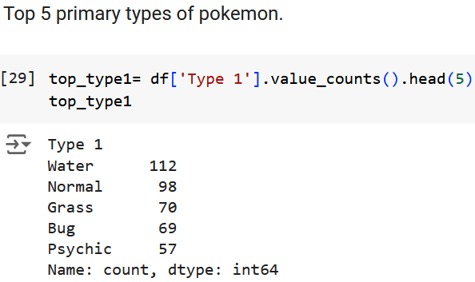
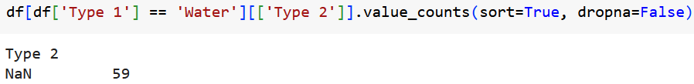
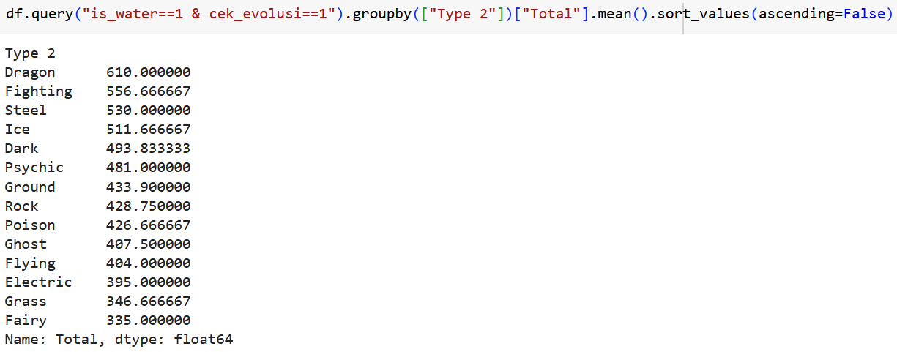
How is the evolution of pokemon’s primary type?
Most of pokemon's primary type is Water and 59 of 112 or over 50% they do not undergo transformation.
Evolution from water to dragon requires an average total 610. The smalest average 335 is required water to be fairy.

Slide 16
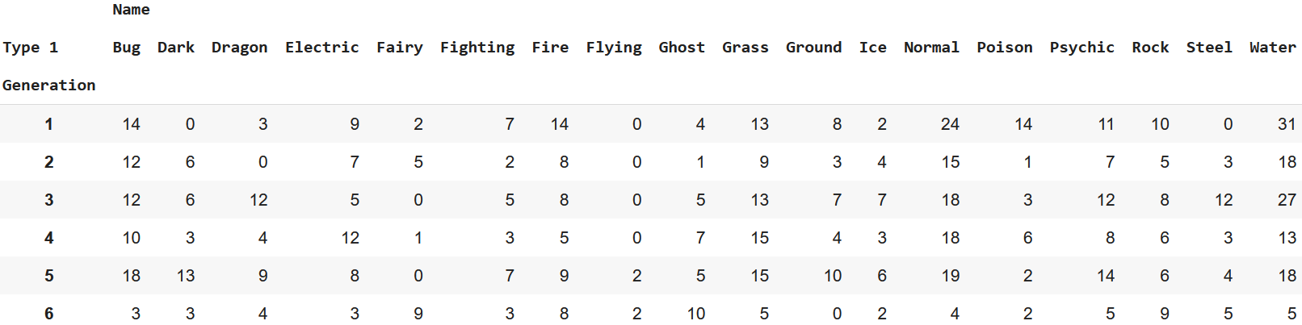
How is the distribution of pokemon primary types for each generation?
Generation 1 has the most Water type, which is 31
Generation 2 has the most Water type, which is 18
Generation 3 has the most Water type, which is 27
Generation 4 has the most Normal type, which is 18
Generation 5 has the most Normal type, which is 19
Generation 6 has the most Ghost type, which is 10

Slide 17
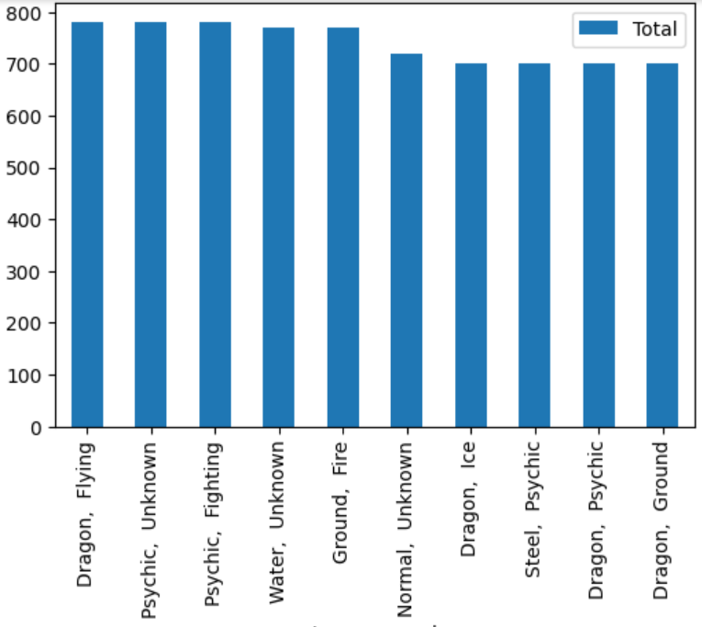
What is the most powerful type combination?
From this it can be concluded that the psychic/dragon of Type 1 and fighting/flying of Type 2 are the most effective type combination so far.

Slide 18
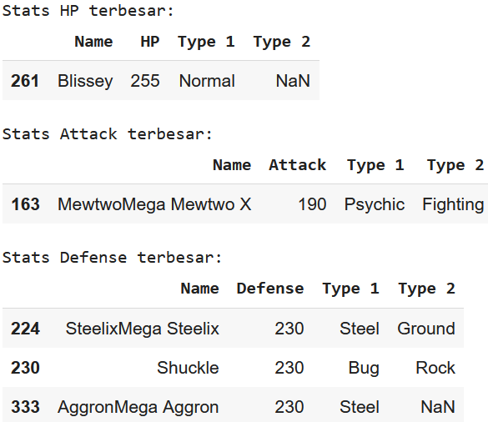
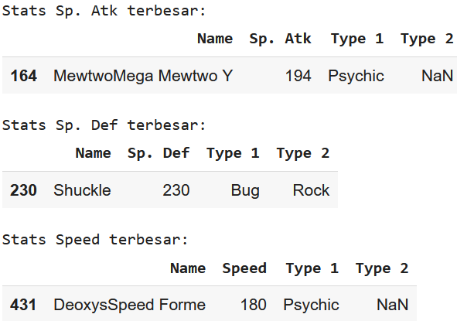
What is pokemon with the strongest base stats for each stats indicator?
Several Pokemon have been obtained that represent the greatest stats for each indicator of stats.
HP : 255
Attack : 190
Defense : 230
Sp. Atk : 194
Sp. Def : 230
Speed : 180

Slide 19
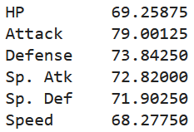
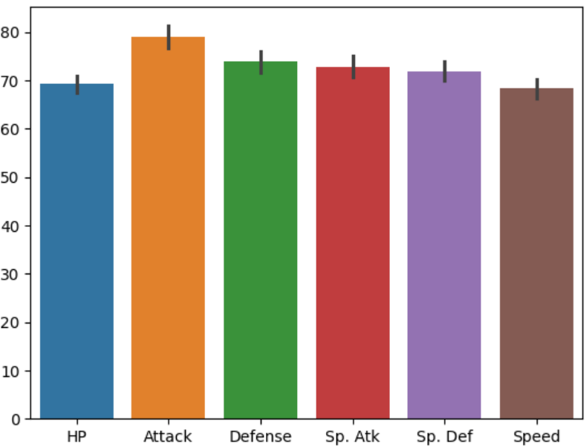
What is the average strength that Pokemon has from several existing indicators?
Pokemon have several stats that are indicators of their strength when fighting. These stats include HP, attack, defense, speed, special attack and special defense.
The average value for each statistic is in the range of 70 to 80. The Pokemon that represents the greatest stats has stats that are almost double the average stats for each indicator.

Slide 20
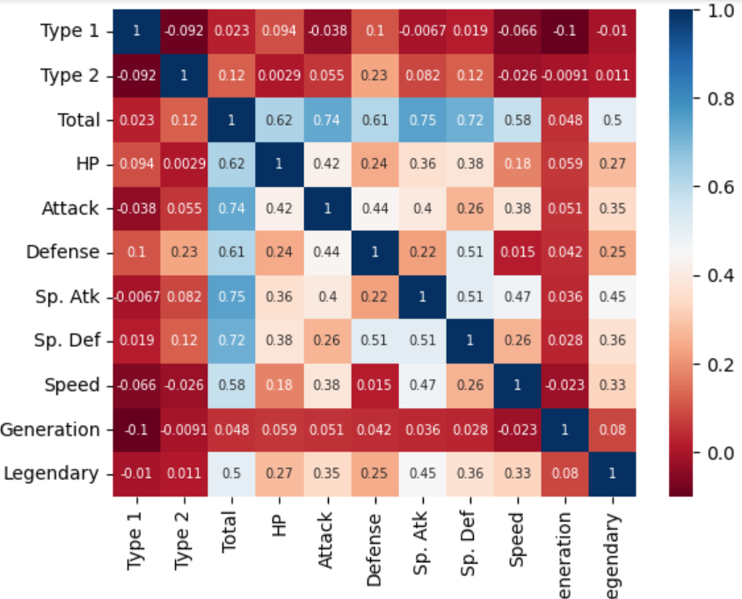
How is the correlation between variables?
As we can see, the high possitive correlation is recognized with the blue color and the low is red color.
Total has a very good correlation (reach 75%) with Sp. Atk among other stats.
Legendary has a very good correlation (reach 50%) with Total.

Slide 21

THANK YOU
endahen12@gmail.com

